Slide 1



SSW 565 FINAL PROJECT Option 2
Khusboo Patel

Slide 2

Introduction
Contributions to open-source libraries are growing at a breakneck pace. Because developers are increasingly depending on open-source libraries to swiftly assemble and create software, these unidentified changes expose their products to auditing or hacking.
Using natural language processing and machine learning approaches, I’ll investigate ways to automatically detect the architectural aspects that are altered by commits to large-scale projects in real time.
In addition to maybe assuring current software development, using the latent information underlying commit messages and bug reports in open source, the SBERT-based classifies obtains promising results on the presented dataset.
We will group the contributions according to their architectural criteria and then add new commits to the existing clusters.

Slide 3
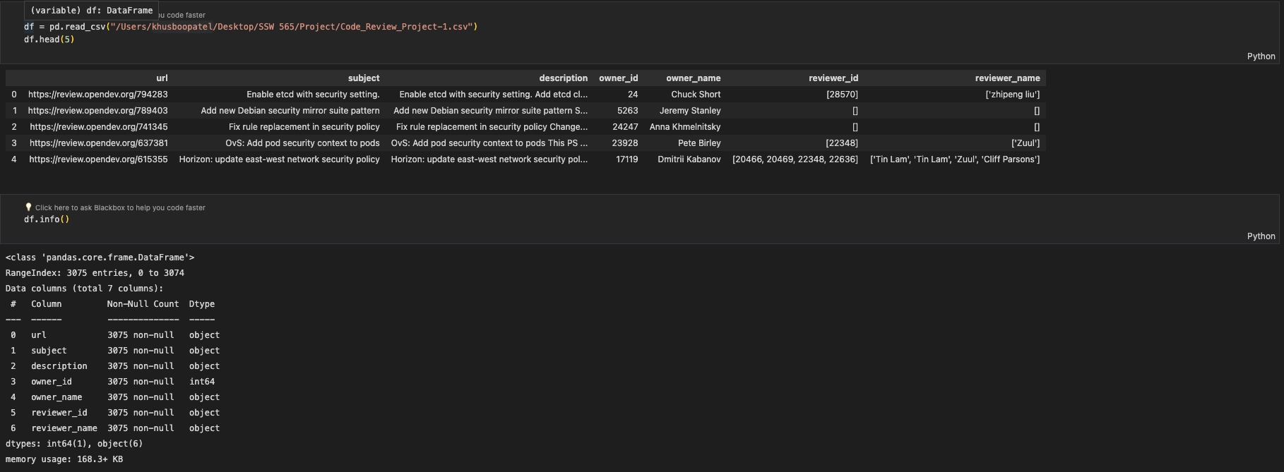
Data Set
Because the subject column are too tiny and might be deceptive, the commit description piques our curiosity.
The description, on the other hand, offers a lot more information that may be used to guess which category the commits fall under.
Fig. 1: code_Review_Project-1.csv

Slide 4
Approach
STEP 1 : Find the relevant Data – The csv file has about 3000 commits messages. Most of the data can be discarded safely but, the commit description can be used to train the desired model.
STEP 2: Remove emails, tokenize words and Clean-up - There are many emails, newline, punctuation marks and extra spaces that aren’t useful for the model training. We can eliminate the English stop words as well to improve accuracy.
STEP 3: Create Bigram and Trigram Models – Bigrams are those two words occurring frequently together in the csv. Similarly, Trigrams are 3 words occurring frequently.
STEP 4: Lemmatize – This step would help in creating the Dictionary and Corpus needed for Topic Modeling.
Model Perplexity and Coherence Score would be computed using this model. The higher the Coherence Score, the stronger the bond between the commits in the cluster.

Slide 5
Clustering Method
Clustering is a well-known technique for resolving the difficulties with unsupervised learning. We’ll use it for evaluating performance, knowing the ground truth labels.
STEP 1: Select embeddings – Numerically represent the text
STEP 2: Dimensionality Reduction – A problem with using the embeddings directly is that distance measures, such as Euclidean and Manhattan, needed for clustering become meaningless at such high dimensions.
STEP 3: Selecting a clustering algorithm - Density-based algorithms are a good option here as they do not require specifying the number of clusters and are indifferent to cluster shape. Hierarchical Density-Based Spatial Clustering of Applications with Noise (HDBSCAN) has become popular since it has fewer and more intuitive hyperparameters than DBSCAN.
STEP 4: Generating clusters from UMAP + HDBSCAN

Slide 6
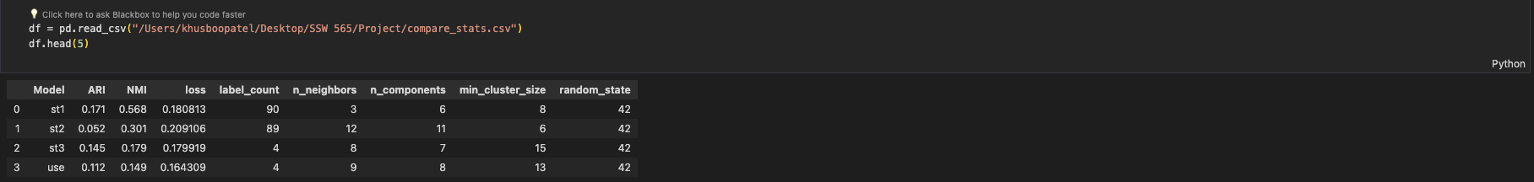
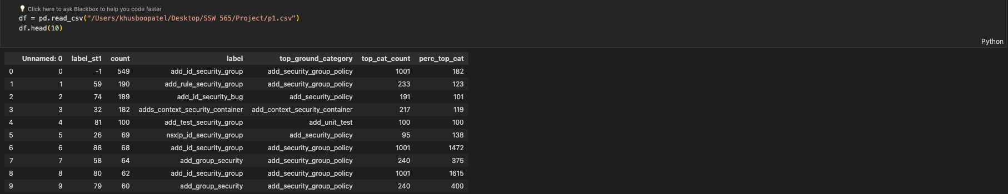
Analysis
Fig. 2: compare_stats.csv
The Adjusted Rand Index (ARI) is frequently used in cluster validation since it is a measure of agreement between two partitions: one given by the clustering process and the other defined by external criteria.
Normalized mutual information (NMI) gives us the reduction in entropy of class labels when we are given the cluster labels. In a sense, NMI tells us how much the uncertainty about class labels decreases when we know the cluster labels. It is like the information gain in decisions trees.
Best loss from out model was 0.164 given in the picture.
Fig. 3. p1.csv

Slide 7





We could apply classification models that do not require complex code analysis and are language agnostic by converting the challenge of categorizing code modifications to the problem of classifying a text containing natural language phrases.
While using a computationally less expensive model and using a much smaller training dataset, our strategy surpasses state-of-the-art approaches
Conclusion

Slide 8

!! Thank You !!

